Slide 1

Krishi Sahayta App
Complete solution for crop insurance claim

Slide 2
Table of contents
01
02
03
Our Project
Problem Statement
Proposed Ideas
04
05
06
Demo
Development Process
Our Team

Slide 3

Our Project
Complete solution to smoothen every aspect of crop insurance settlement for local farmers, State Government and Insurance Company

Slide 4
̣̣̣̣̣̣̣̣̣̣̣̣̣̣̣̣
Krishi Sahayta App
SMS Notification
Local Language Support
Tracking using Aadhar
Yield Estimation using Image Processing
Claim verification using Meteorolog-ical data
Help feature for guidance

Slide 5
Features of Our Project
For local farmers-
SMS notification after completion of each step
Local-language support
Guidance on insurance policy
Video tutorials to create awareness
Feature to track status of claim using Aadhar
Helpline
For Govt. of Odisha and Insurance Companies-
Use of Image Processing to simplify yield estimation
Verification of claims using meteorological dept. data and image processing
Resolvement of delayed claim settlements using greedy algorithms
Implementation of transparency using Aadhar

Slide 6

Problem Statement
Without proper implementation and modern
infrastructure, a crop insurance scheme is not
sufficiently lucrative for either the farmers or
private insurance companies. The scheme can
fly very high if the operational guidelines are
strictly followed by them.

Slide 7
Issues Identified
For Farmers-
Bad user-interface
Lack of information outreach to farmers
Lack of trackability
No local-language support
No assurance against false rejections
Due to crop diversity, insufficient knowledge about right policies to apply for
For Govt. of Odisha-
No assurance against false claims
Reliable yield-estimation
Lack of Transparency
Inter-departmental communication gap

Slide 8
Development Process

Slide 9
Tech Stacks Used-
HTML
CSS
JavaScript
JQuery
Bootstrap
Tailwind CSS
React
GitHub
MySQL
Python
Algorithms

Slide 10
Demo

Slide 11
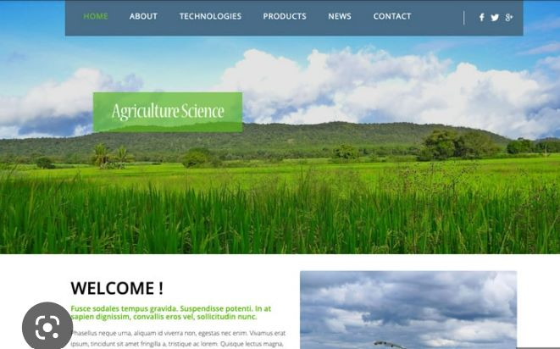
Layout

Slide 12
Our Team
Complete solution to smoothen every aspect of crop insurance settlement for local farmers, State Government and Insurance Company

Slide 13
Team Members
Om Tanmaya Pati (fullstack)
Sumit Dash (Database, frontend)
Smriti (backend)
Sudiksha Sharma (fullstack)
Mentor: Chanchal Anand (Domain Expert, technical consultant)

